Slide 1

ELECTRIC LOAD FORECASTING USING DEEP LEARNING TECHNIQUES
MS Computer Science
HAFIZ SHAZIM KAREEM
ROLL NO: 3403
SUPERVISOR: DR. MUHAMMAD KASHIF HANIF
Session 2018-20
Department
Computer Science
2019

Slide 2



Slide 3
TABLE OF CONTENTS
Introduction
Literature review
Problem Statement
Motivation
Research Questions
Research Objectives
Methodology

Slide 4

INTRODUCTION

Slide 5
INTRODUCTION
ELECTRIC LOAD FORECASTING USING DEEP LEARNING TECHNIQUES
The device which takes electrical energy is known as the electric load.
The electrical load is a device that consumes electrical energy .
Electricity is part of technologies and it has a great impact on human life from various angles. As population increased, the demand for electricity increased too. With the help of electrical load forecasting, future requirements of energy load can be predicted.
Short Term Load Forecasting (one day to some weeks )
Very Short Term Load Forecasting (one hour to several hours)
Medium Term Load Forecasting (one month to one year )
Long Term Load Forecasting (solitary year to numerous years )
Notes:
Write your notes here.
Write here what you will speak during the presentation

Slide 6
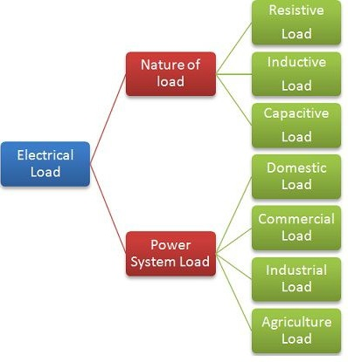
INTRODUCTION
ELECTRIC LOAD FORECASTING USING DEEP LEARNING TECHNIQUES
Notes:
Write your notes here.
Write here what you will speak during the presentation

Slide 7

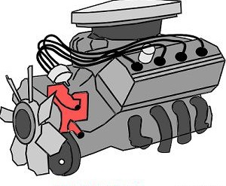
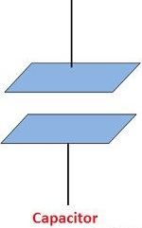
INTRODUCTION
ELECTRIC LOAD FORECASTING USING DEEP LEARNING TECHNIQUES
Resistive Load
The resistive load checks the flow of electrical energy in the circuit and converts it into thermal energy.
Inductive load
The inductive loads use the magnetic field for doing the work. The transformers, generators, motor are the examples of the load
Capacitive Load
In the capacitive load, the voltage wave is leading the current wave. The examples of capacitive loads are capacitor bank, three phase induction motor starting circuit, etc.
Notes:
Write your notes here.
Write here what you will speak during the presentation

Slide 8
INTRODUCTION
ELECTRIC LOAD FORECASTING USING DEEP LEARNING TECHNIQUES
Domestic Load
The domestic load is defined as the total energy consumed by the electrical appliances in the household work.
lights, fan, refrigerator, air conditioners, mixer, grinder, heater etc.
Commercial Load
Commercial load mainly consist of lightning of shops, offices, advertisements, market restaurants etc.
Industrial Load
Industrial load consists of small-scale industries, medium scale industries, large scale industries, heavy industries and cottage industries. eg Induction motors etc.
Agriculture Load
This type of load is mainly motor pumps-sets load for irrigation purposes. The load factor of this load is very small e.g. 0.15 – 0.20.
Notes:
Write your notes here.
Write here what you will speak during the presentation

Slide 9
LITERATURE REVIEW

Slide 10
LITERATURE REVIEW
ELECTRIC LOAD FORECASTING USING DEEP LEARNING TECHNIQUES
Sr. No | Year | Techniques | Objective | Dataset | Performance/Results | Limitations
1 | 2017 | Back propagation neural network (BPNN), adaptive differential evolution back propagation neural network (ADeBPNN) (Zeng et al., 2017) | Load forecasting | Four elements, GDP, POP, IMP, and EXP, are selected as the descriptive variables to forecast the EEC in Turkey. | MAPE 0.34% | Accuracy rate does not satisfactory
2 | 2018 | Adaptive Neuro-Fuzzy Inference System (ANFIS), Kohonen Self Organizing Map (SOM) (Nazar et al., 2018) | 24 hour ahead Load and price forecasting | One year dataset | MAPE 1.75% | Results can be better with improving the feature selection techniques
3 | 2018 | Neural Network based Particle Swarm Optimization (NNPSO) Neural Network based Genetic Algorithm (NNGA), (Muralitharan et al., 2018) | Load forecasting | 5 years of data from Pecan Street | MSE 0.387 % | For the infrastructure of the power network scenario is not good
Notes:
Write your notes here.
Write here what you will speak during the presentation

Slide 11
LITERATURE REVIEW
ELECTRIC LOAD FORECASTING USING DEEP LEARNING TECHNIQUES
Sr. No | Year | Techniques | Objective | Dataset | Performance/Results | Limitations
4 | 2018 | Generalized Extreme Learning Machine (GELM), Improved Wavelet Neural Network (IWNN), (Rafiei et al., 2018) | Load forecasting | One year dataset | 95% accuracy rate | Accuracy rate not satisfactory
5 | 2018 | Deep Residual Networks (DRN) (Chen et al., 2018) | Short Term Load Forecasting | Three public datasets | MAPE 1.47% | Efficiency and execution time have not reduced.
6 | 2017 | K-Nearesr Neighbour (KNN), Long Short Term Memory (LSTM) (Kong et al., 2019) | Load Forecasting | 10,000 residential customers | LSTM (MAPE 8.58) KNN (MAPE 11.23) | Without tweaking of parameter not give good outcomes
Notes:
Write your notes here.
Write here what you will speak during the presentation

Slide 12
LITERATURE REVIEW
ELECTRIC LOAD FORECASTING USING DEEP LEARNING TECHNIQUES
Sr. No | Year | Techniques | Objective | Dataset | Performance/Results | Limitations
7 | 2019 | Deep Convolutional Neural Network (DCNN) (Khan et al., 2019) | Load Forecasting | 4 month dataset taken from Australian energy market operator | MAPE 2.1% | Redundancy in features are not discussed
8 | 2018 | Convolutional Neural Network (CNN), Long Short Term Memory (LSTM), (Tian et al., 2018) | Short Term Load Forecasting | 2 years of data taken from Italy with one hour sampling | MAPE 0.0396% RMSE 1134.17 % MAE 692.14 % | Redundancy in features are not discussed
9 | 2019 | Support Vector Machine (Ayub, B, Mujeeb, & Zahid, 2019) | Short Term Load Forecasting | 3 years dataset taken from ISO/NE | MAPE 1.682 | Tune the parameters manually
10 | 2019 | Convolutional Neural Network (CNN), Autoregressive Integrated Moving Average With Exogenous Inputs (ARIMAX) (Cai et al., 2019) | Load forecasting | Dataset gathered from different buildings which are located Alexandra city. One hour gap for a solitary year time with 5% of mislaid data | RMSE Non Cool 5.1 Cool 3.4 | Complex to execute in different datasets
Notes:
Write your notes here.
Write here what you will speak during the presentation

Slide 13
PROBLEM STATEMENT

Slide 14
PROBLEM STATEMENT
ELECTRIC LOAD FORECASTING USING DEEP LEARNING TECHNIQUES
For the purpose of optimal operation and planning in electrical utility companies, there is much need for proper framework that can be used to know present and future need for electricity. Therefore, there is really need a better framework that can be used for load forecasting.
Notes:
Write your notes here.
Write here what you will speak during the presentation

Slide 15
MOTIVATION

Slide 16
MOTIVATION
ELECTRIC LOAD FORECASTING USING DEEP LEARNING TECHNIQUES
Every researcher have been tried his best to give a better framework to perform load forecasting but they have some limitations:
Redundancy of features does not discuss.
Some researchers only used specific datasets.
We use feature selection and extraction method to remove redundant features and will use datasets to perform load forecasting.
Notes:
Write your notes here.
Write here what you will speak during the presentation

Slide 17
RESEARCH QUESTIONS

Slide 18
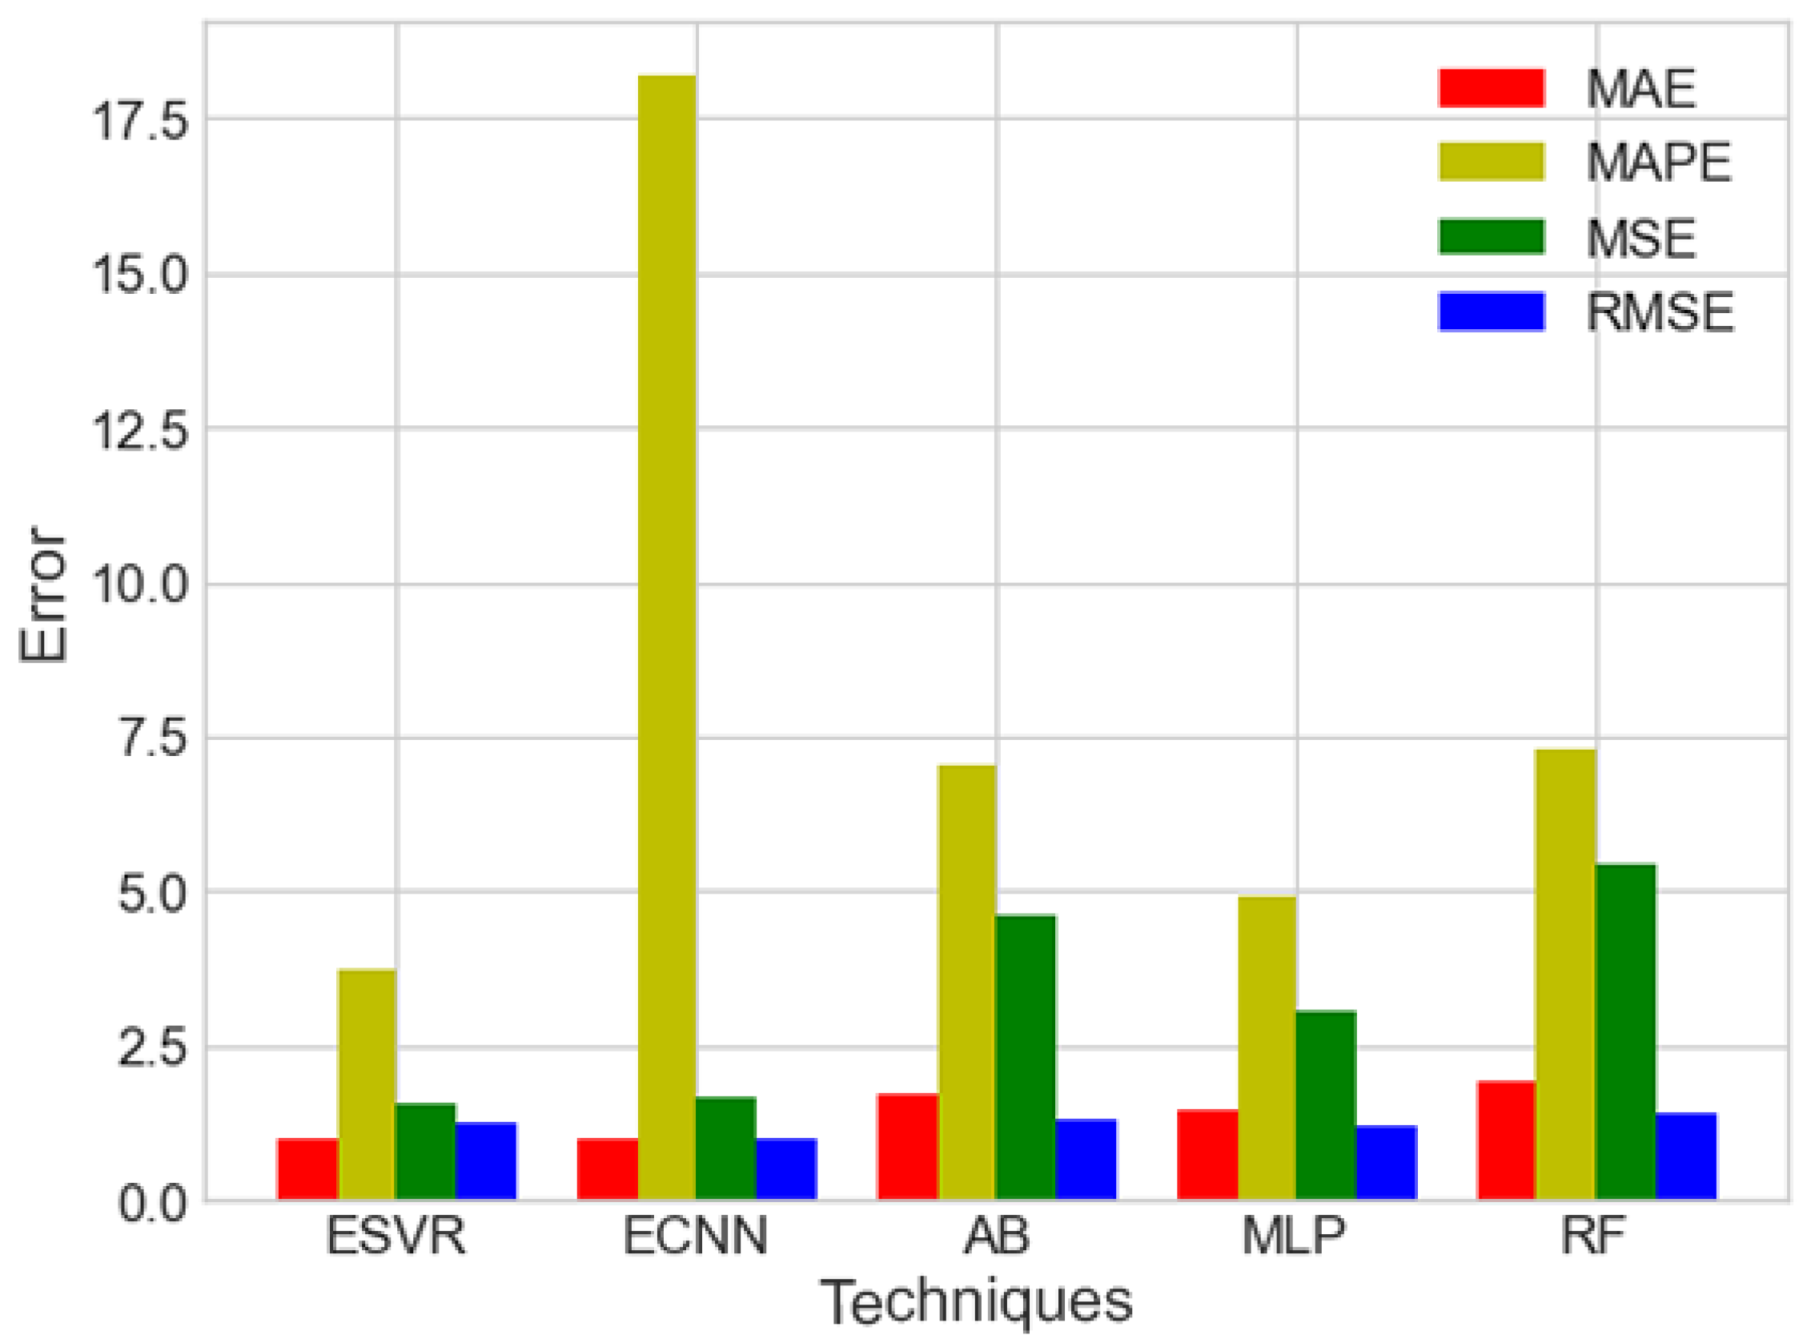
RESEARCH QUESTIONS
ELECTRIC LOAD FORECASTING USING DEEP LEARNING TECHNIQUES
How to improve the accuracy rate of the load forecasting technique?
Notes:
Write your notes here.
Write here what you will speak during the presentation

Slide 19
RESEARCH OBJECTIVES

Slide 20
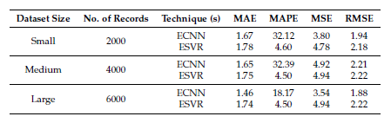
RESEARCH OBJECTIVES
ELECTRIC LOAD FORECASTING USING DEEP LEARNING TECHNIQUES
The objective of this work is performing load forecasting using different datasets.
Notes:
Write your notes here.
Write here what you will speak during the presentation

Slide 21
METHODOLOGY

Slide 22
METHODOLOGY
ELECTRIC LOAD FORECASTING USING DEEP LEARNING TECHNIQUES
Step 1: Pre-processing
Take datasets, 25 % features will be divided into testing and 75% features of each dataset will be separated for training purposes.
Step 2: Feature Selection
The main related attributes will be chosen using combination of Extreme Gradient Boosting (XGB).
Step 3: Feature Extraction
Feature Extraction will be performed using Recursive Feature Eliminator (RFE) .
Step 4: Classification
For the classification I will use Hybrid of Convolutional Neural Network (CNN) and Particle Swarm Optimization (PSO). Further, hybrid technique will be compared with some conventional technique to show improvement of our hybrid technique.
Step 5: Result
Results will be calculated using Root Mean Square Error (RMSE) and Mean Absolute Error (MAE) evaluators.
Notes:
Write your notes here.
Write here what you will speak during the presentation

Slide 23
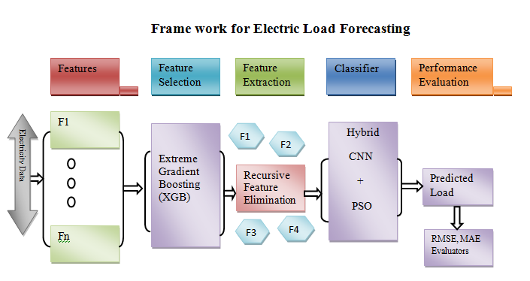
METHODOLOGY
ELECTRIC LOAD FORECASTING USING DEEP LEARNING TECHNIQUES
Notes:
Write your notes here.
Write here what you will speak during the presentation

Slide 24

THANK YOU

